Slide 1
Capstone Design Team F
진행 상황
2016310237 김동우
2016314577 김동한
2016311033 김영현
2017312329 최형규

Slide 2
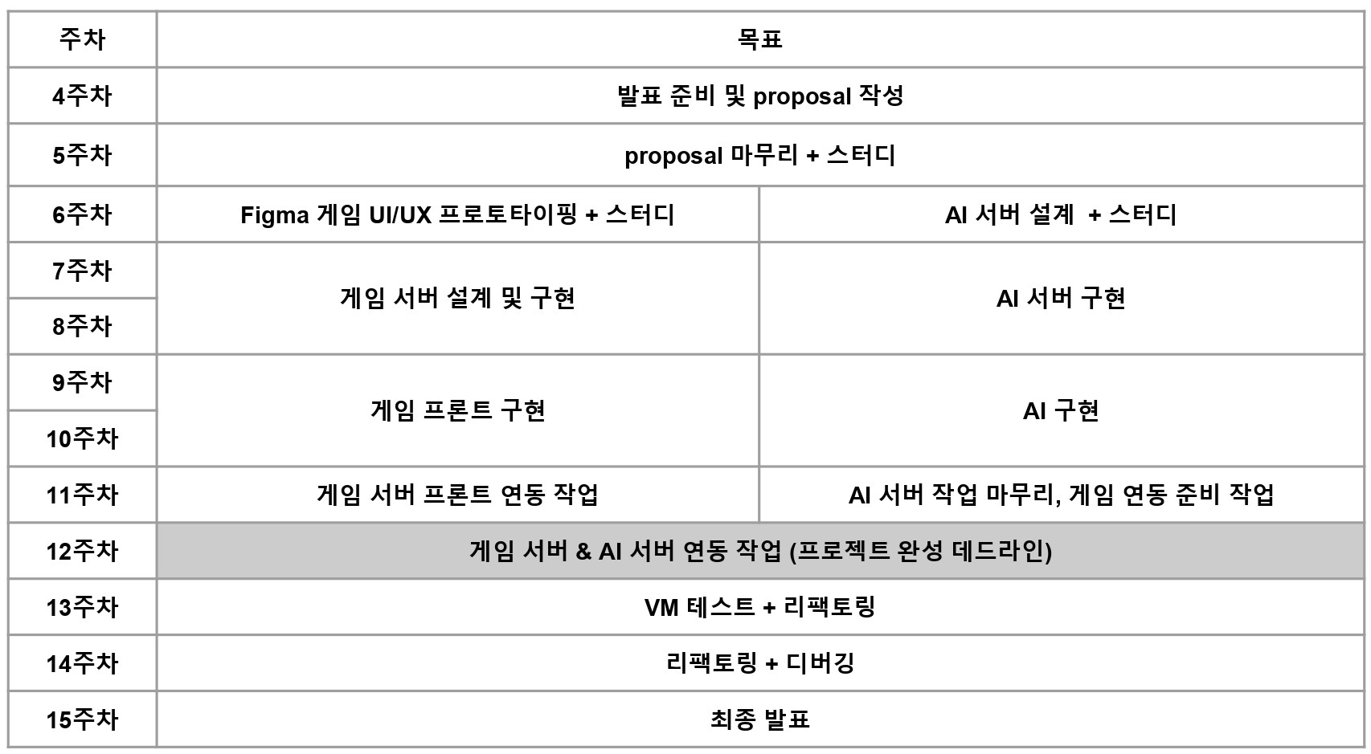
Weekly Plan

Slide 3
진행 상황 - Game
User Log in
Notification to other users

Slide 4
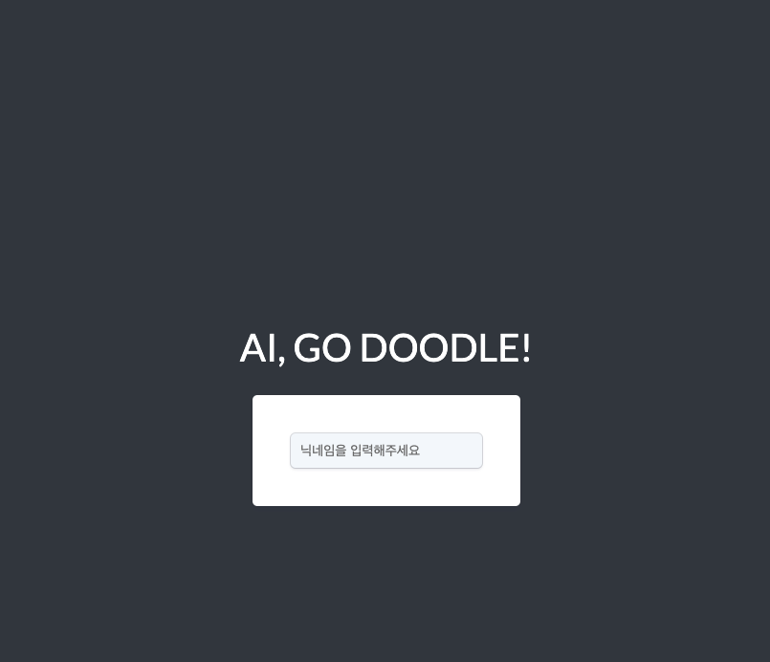
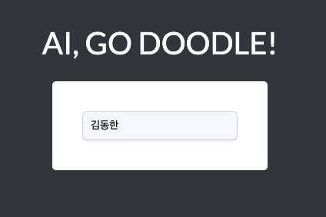
진행 상황 - Game / User Login
Press Enter to Login

Slide 5
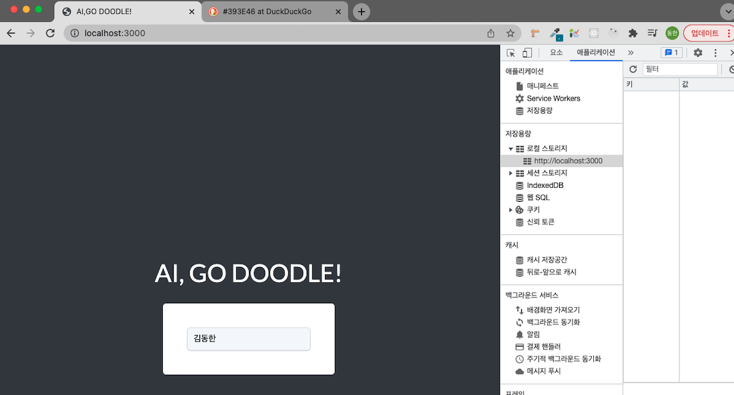
진행 상황 - Game / User Login

Slide 6
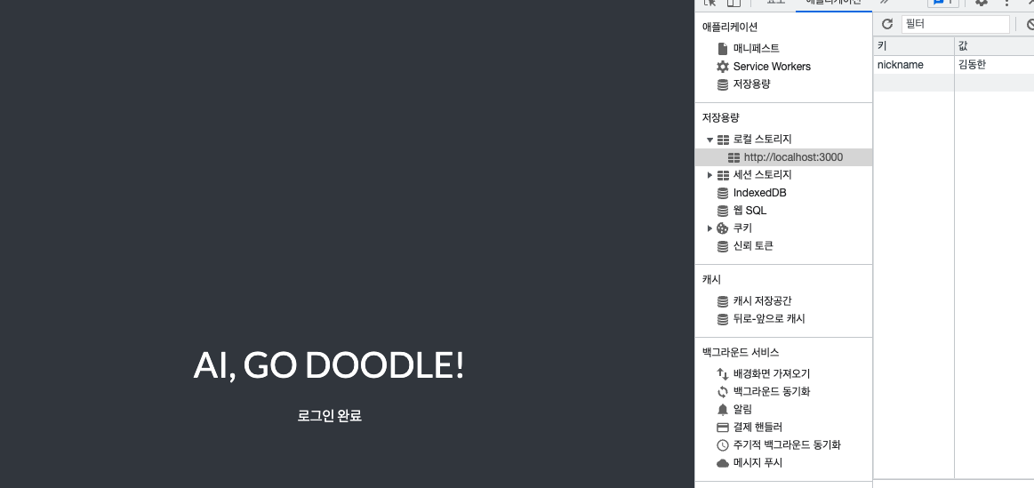
진행 상황 - Game / User Login
-Save user data to Local Storage

Slide 7
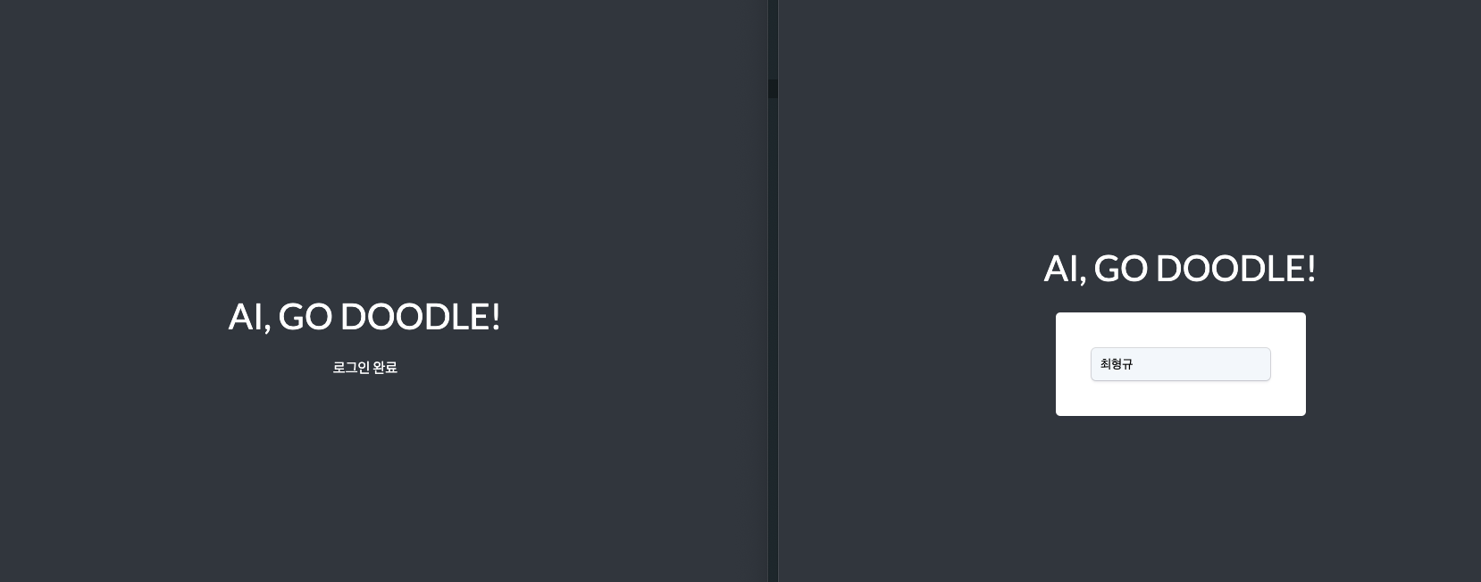
진행 상황 - Game / Notification
User : 김동한
New user : 최형규
Communicate with other browser

Slide 8
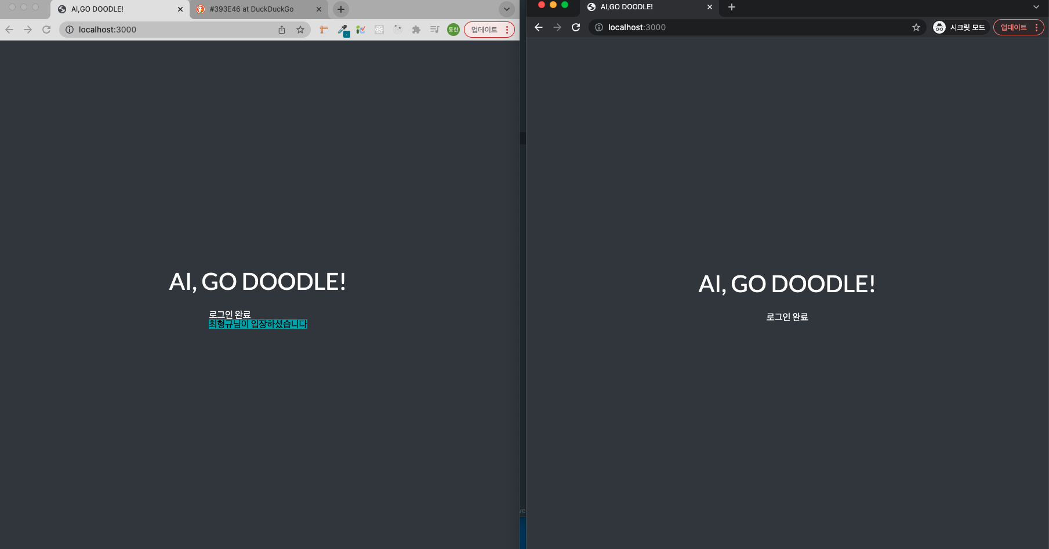
User : 김동한
New user : 최형규
새로운 유저 접속 알림 -> 김동한 유저

Slide 9
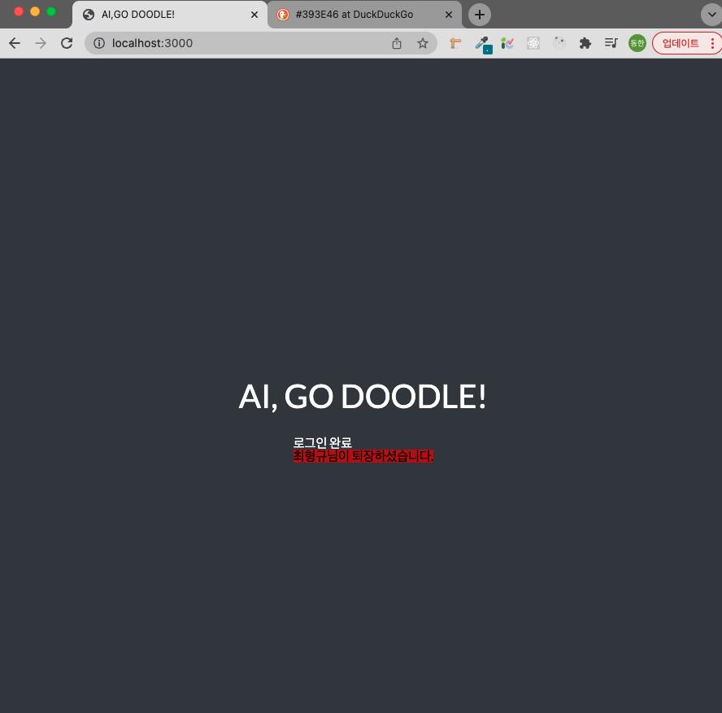
유저 퇴장 알림
User : 김동한
New user : 최형규
새로운 유저 접속 알림 -> 김동한 유저

Slide 10
TODO - Game
Game
New user : 최형규
User logout
Chating
Make canvas
(html5 canvas)

Slide 11

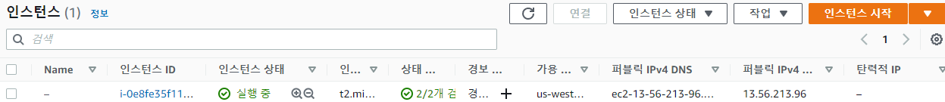
진행 상황 - A.I Server

Slide 12
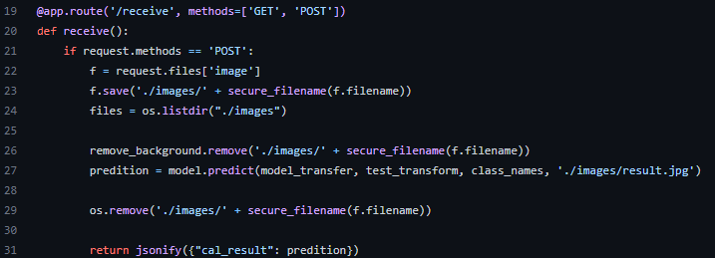
진행 상황 - A.I Server

Slide 13
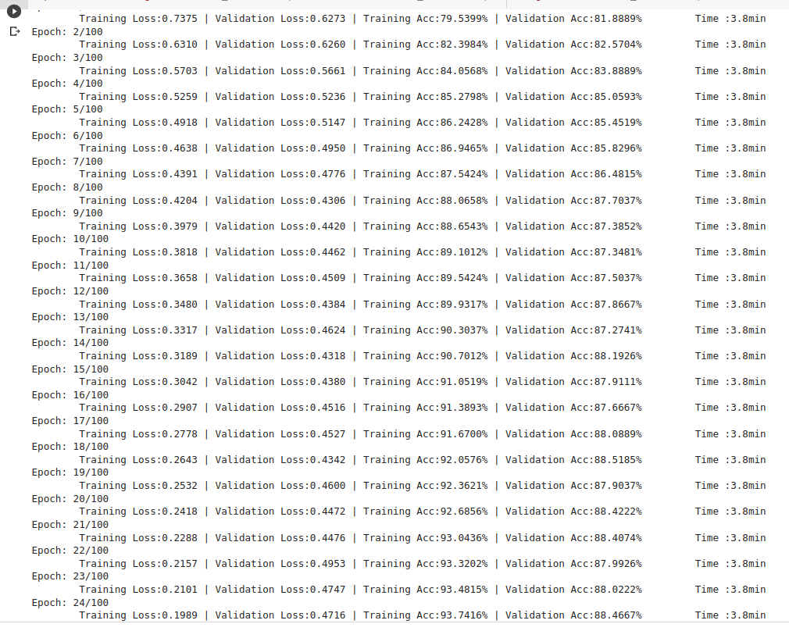
Resnet34
resnet34)
class 50
image/class = 3000
initialization= He initializaiton
augmentation=flip, random rotation

Slide 14
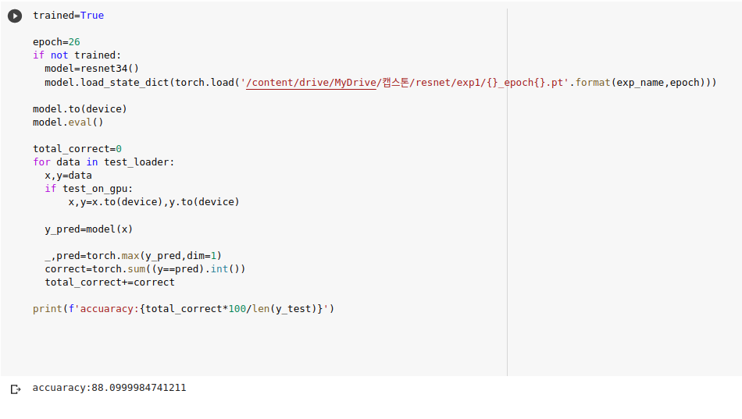
Resnet34
val_acc=88.5%
test_acc=88.1%
- got higher score than vgg19

Slide 15
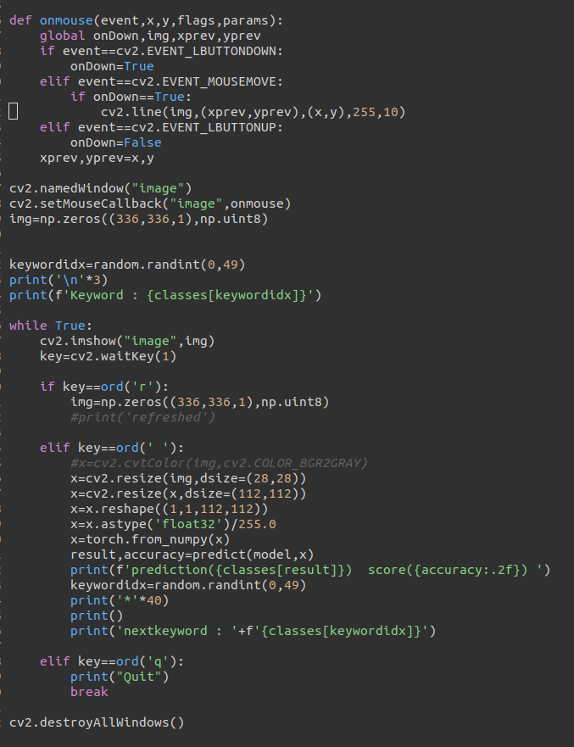


Demo
Demo)
openCV+pytorch
functions
- random selected keywords
- user draw the doodle for the keyword
- model predicts user’s doodle and print its prediction & score

Slide 16
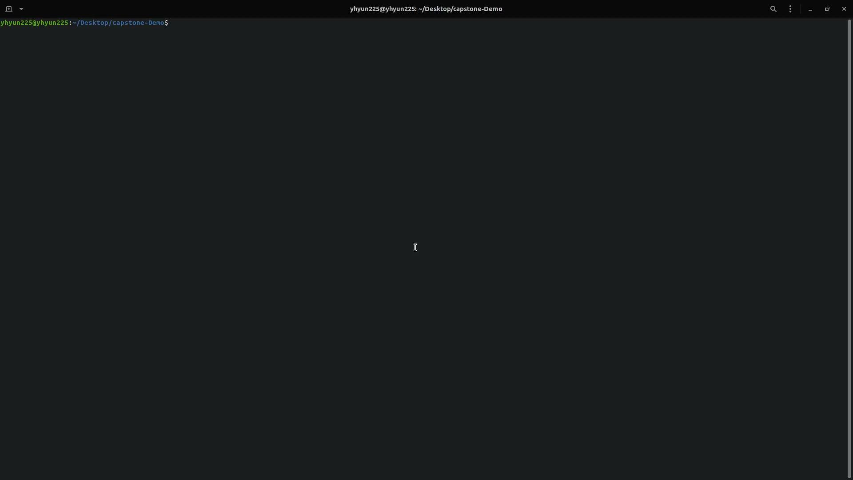
Demo

Slide 17
AI part TO-DO
A.I
Testing server with pytorch
test with resnet50
test with more data(3000->5000)

Slide 18
Thank you

